Slide 1
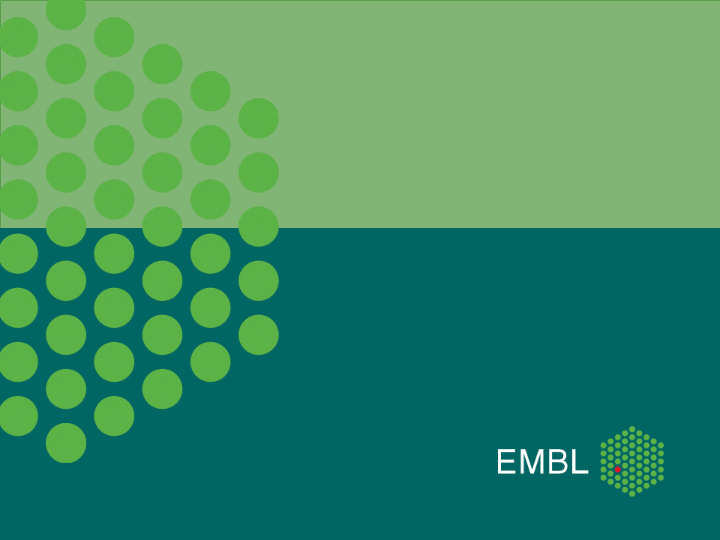
Protein-Protein Interactions: Databases and Visualization
Hugo Samano-Sanchez
European Molecular Biology Laboratory, Heidelberg
November 23rd, 2017

Slide 2

The Outline
Protein Networks
STRING
IntAct
KEGG
Complex Databases
Examples
Exercises

Slide 3
Protein Networks

Slide 4
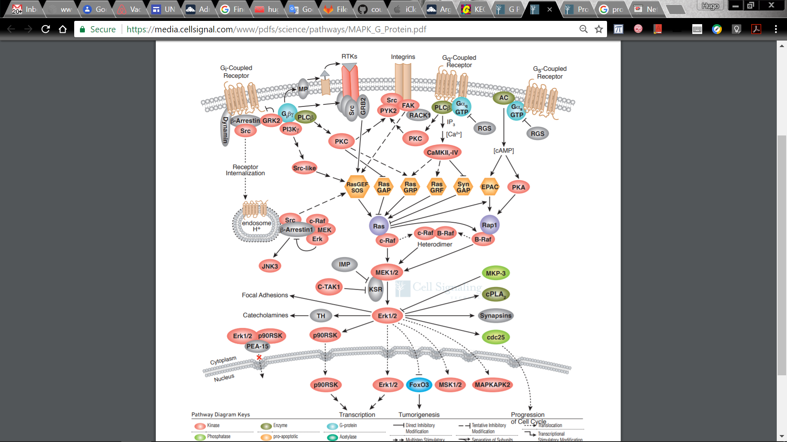
Protein Networks
https://media.cellsignal.com/www/pdfs/science/pathways/MAPK_G_Protein.pdf

Slide 5
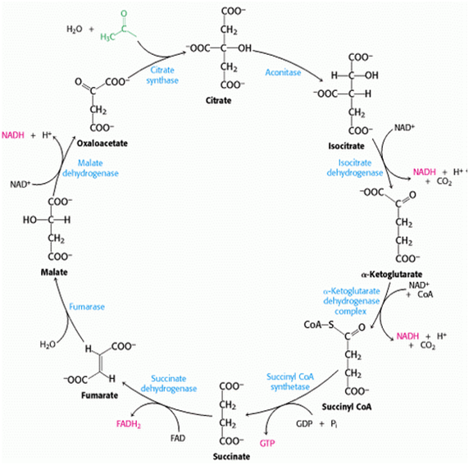
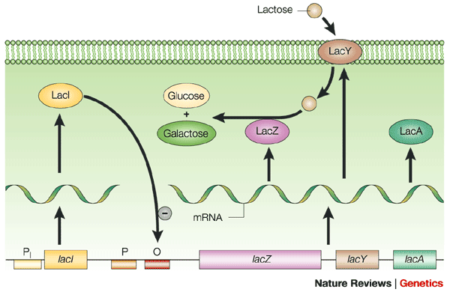
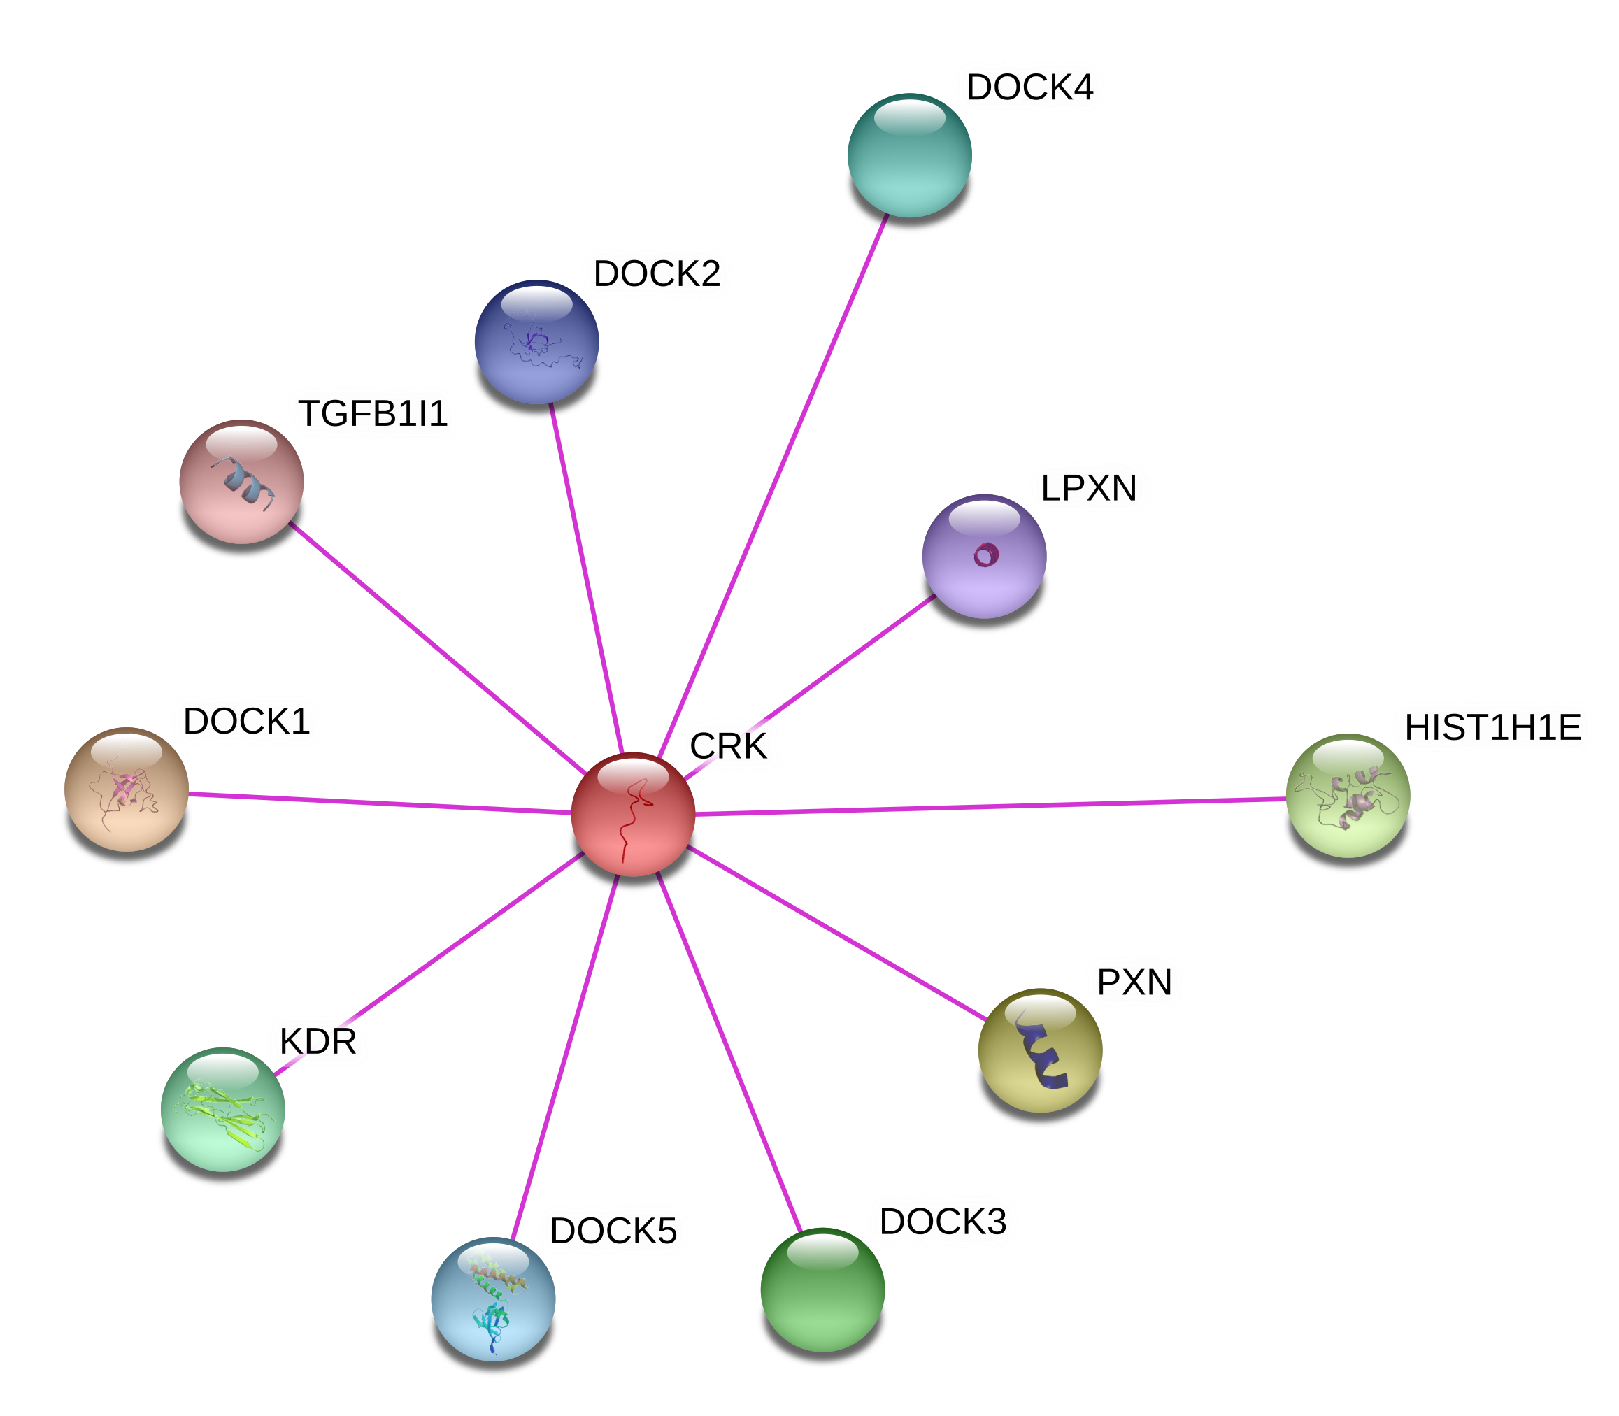
Different types of networks
Metabolic Pathways Regulatory Networks
Signaling Pathways Protein-Protein Interaction Networks
http://www.namrata.co/wp-content/uploads/2013/09/TCA-Cycle.png
http://www.nature.com/scitable/content/7005/10.1038_nrg1087-f1_full.gif
https://media.cellsignal.com/www/pdfs/science/pathways/MAPK_G_Protein.pdf
STRING
Notes:
lacZ is β-galactosidase.
lacY encodes Beta-galactoside permease
lacA encodes β-galactoside transacetylase.

Slide 6
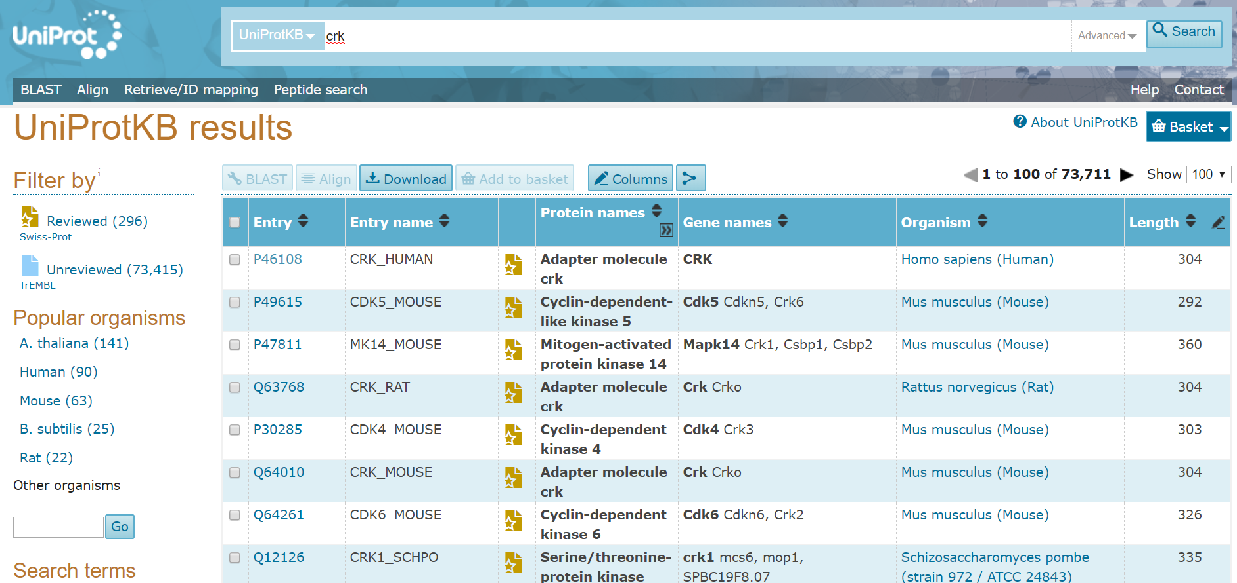
Example 1: What is CRK doing?
http://www.uniprot.org/uniprot/P46108
Notes:
Find CRK in uniprot
See the domains
See Interprot entry for N-SH3
See SOS and look if it is a known interactor with CRK

Slide 7
Exercise 1: What is CRK doing?
Question 1: What evidence exists that CRK interacts with Abl1?
Question 2: Which domains are involved in the interaction?

Slide 8
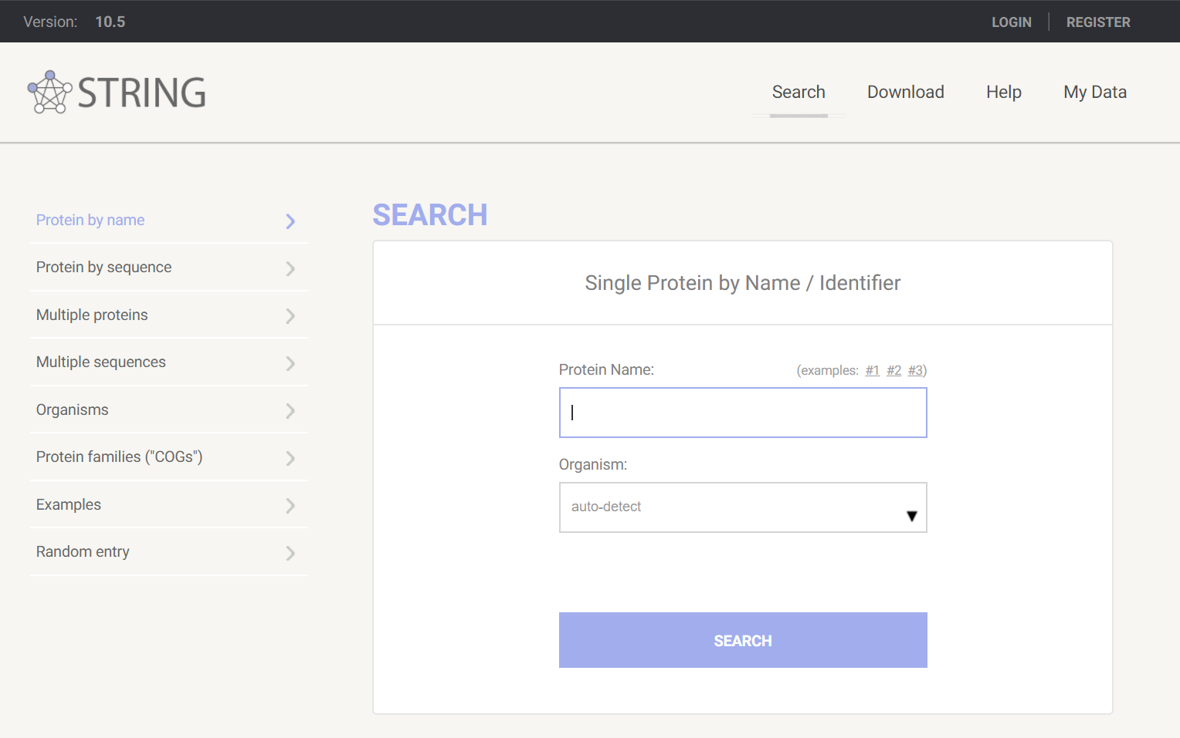
STRING
http://string-db.org

Slide 9
Example 1: CRK in STRING
Find CRK in Homo sapiens
Select only Experimentally validated links and show the expected 40 interactors
See the score with Abl1
Which publication showed the pull down of CRK and Abl1?

Slide 10
Exercise 2: Is the binding of CRK and Abl1 conserved in flies?
Find the CRK homologue in Drosophila melanogaster
Look for the experimentally validated cases

Slide 11
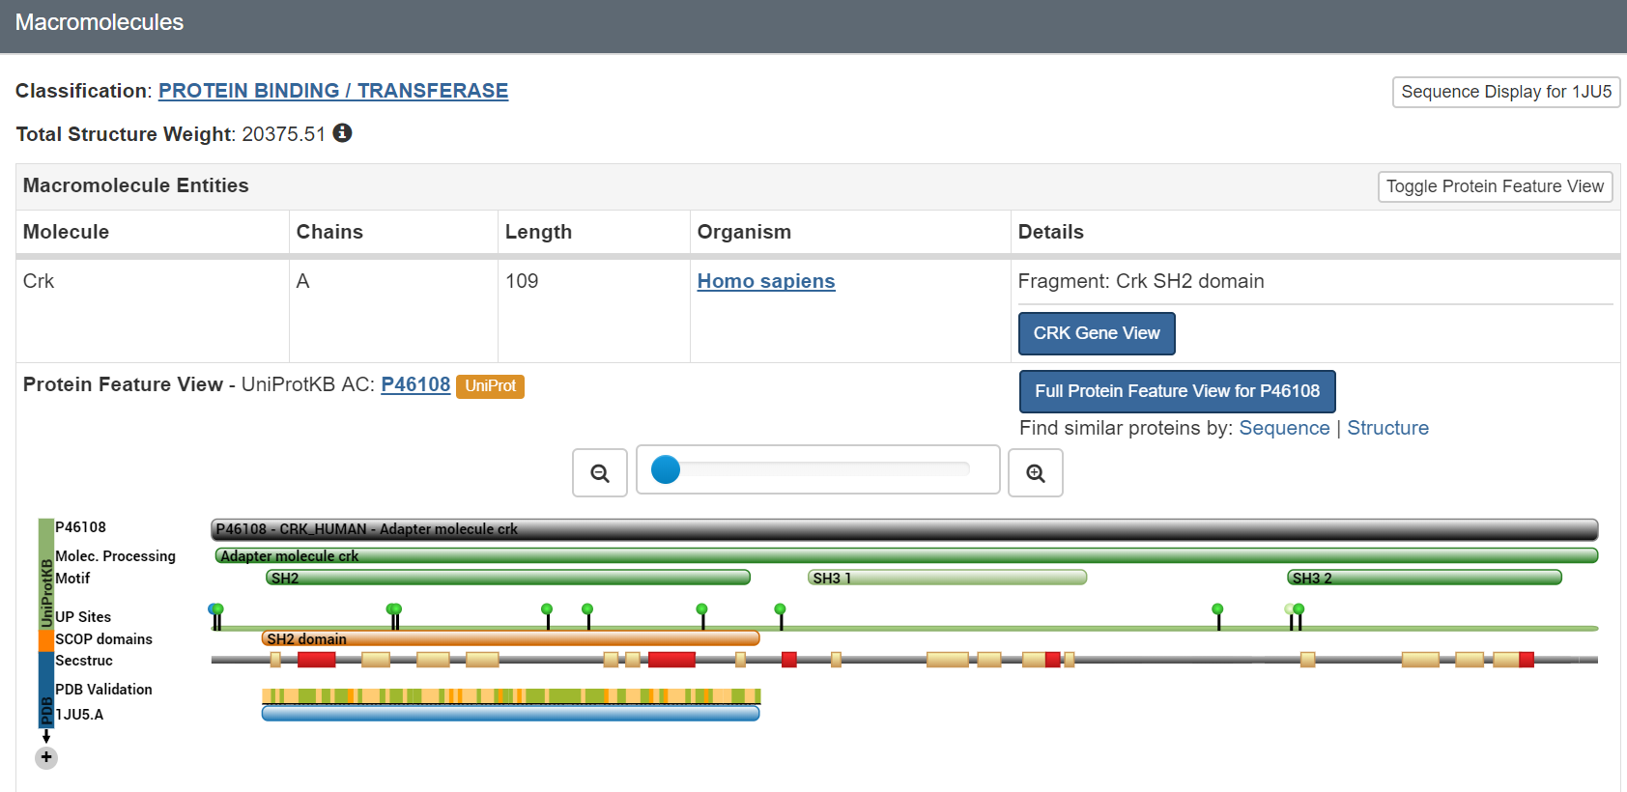
Why is it lost?
http://www.uniprot.org/uniprot/P46108#structure
Select: 1JU5

Slide 12
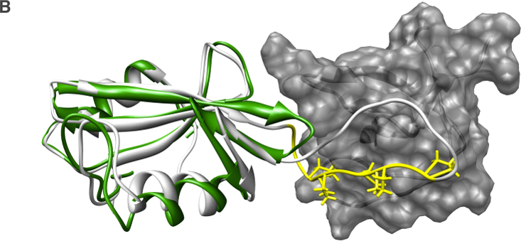
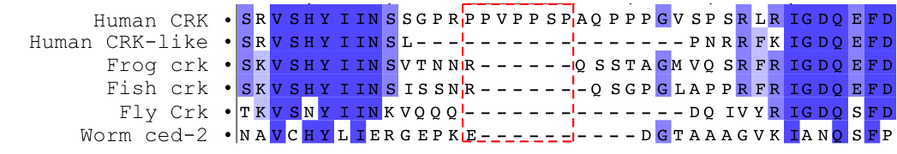
Why is it lost?
CRK
CRK-like
Abl1
SH3 binding motif

Slide 13
Example 2: Finding functional hints with STRING
Search for Human NCK1
Explore any cluster formed. Expand the network and show up to 20 proteins to see additional second interactors.
Click on the proteins to scan the description and see key words.
Let STRING do a statistical analysis of the annotated data for these proteins.
Check the enriched KEGG pathways and click on “Regulation of actin cytoskeleton” and click on “lamellipodium” under Cellular Component (GO).

Slide 14
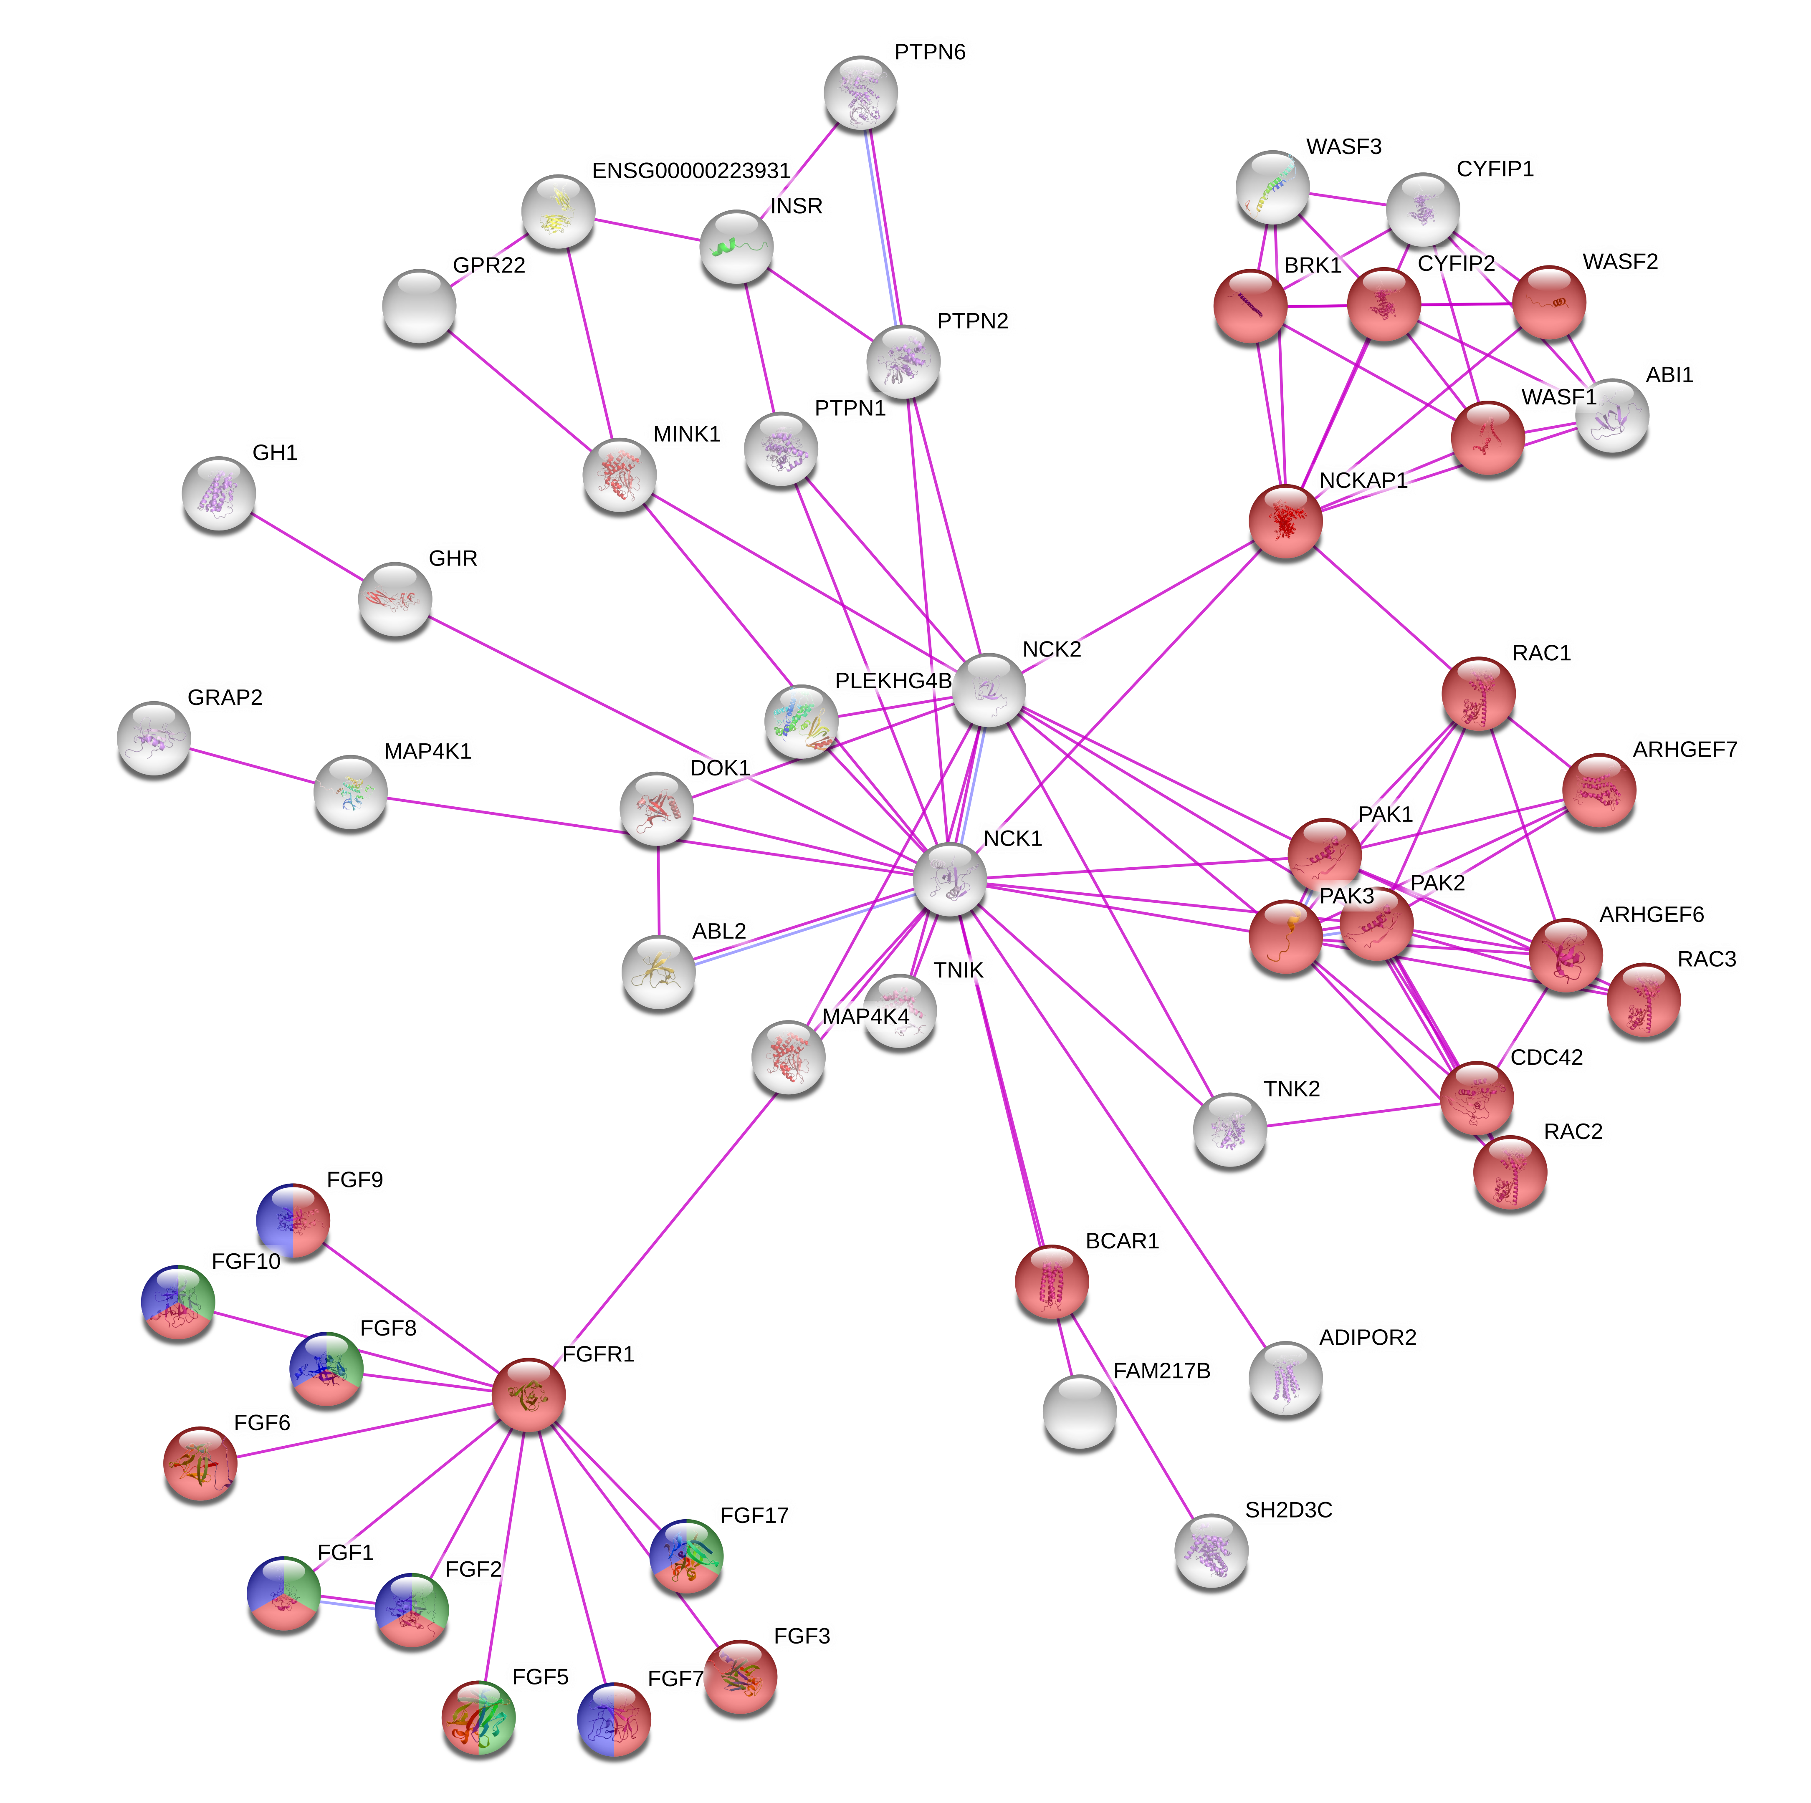
Exercise 3
The cluster formed around FGFR1 is annotated in the “Regulation of actin cytoskeleton” but not related to Lamellipodia.
Could you infer which molecular function this cluster corresponds to?
Regulation of actin cytoskeleton
GO: fibroblast growth factor receptor binding
Domain: Fibroblast growth factor family

Slide 15
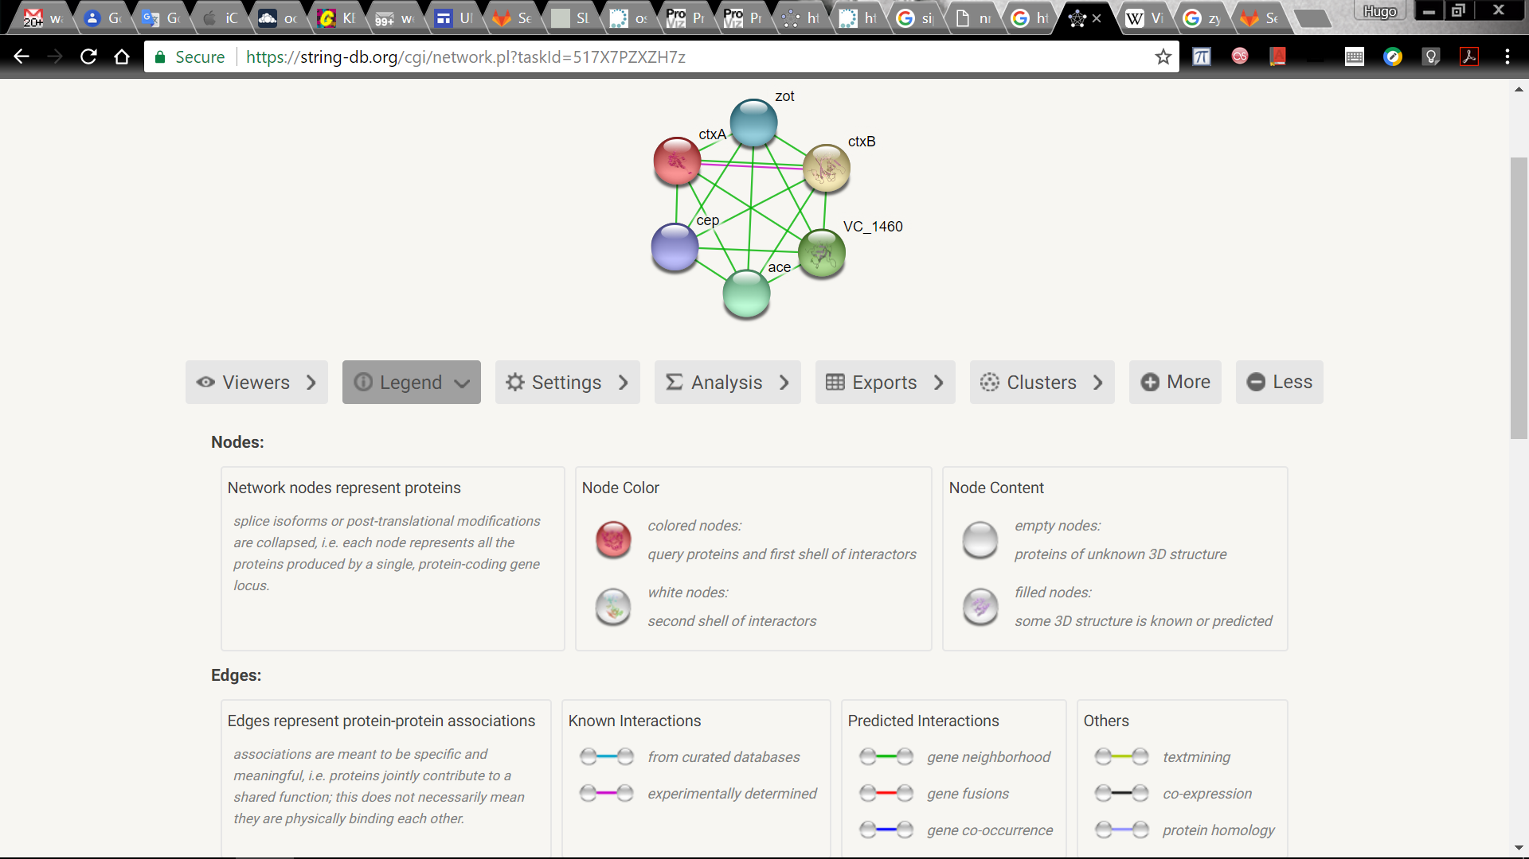
Example 3: Using STRING with a bacterial protein
Search ctxA from Vibrio cholera 01

Slide 16
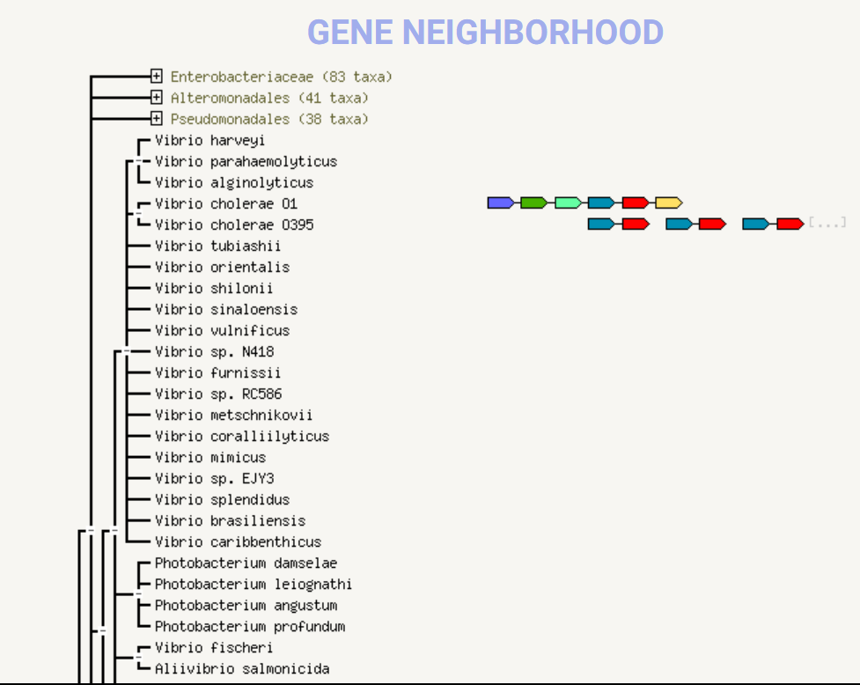
Example 3: Using STRING with a bacterial protein
2. Look for the gene neighborhood

Slide 17
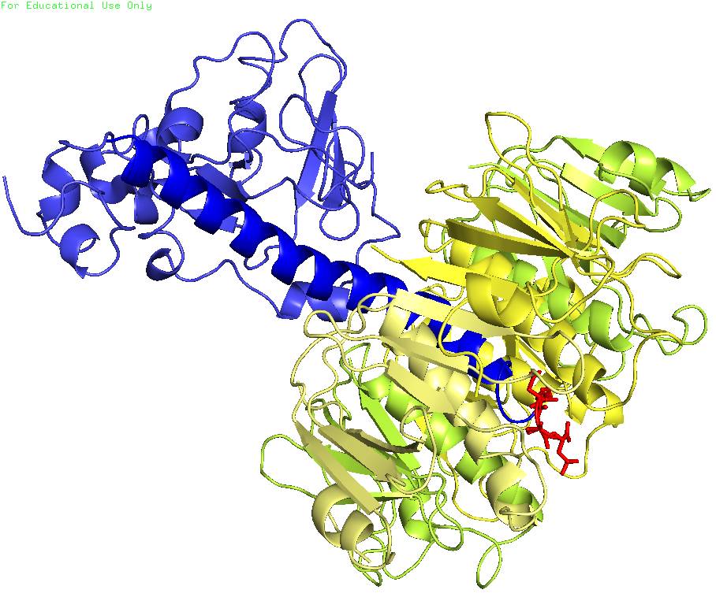
Example 3: Using STRING with a bacterial protein
B subunits
A subunit

Slide 18
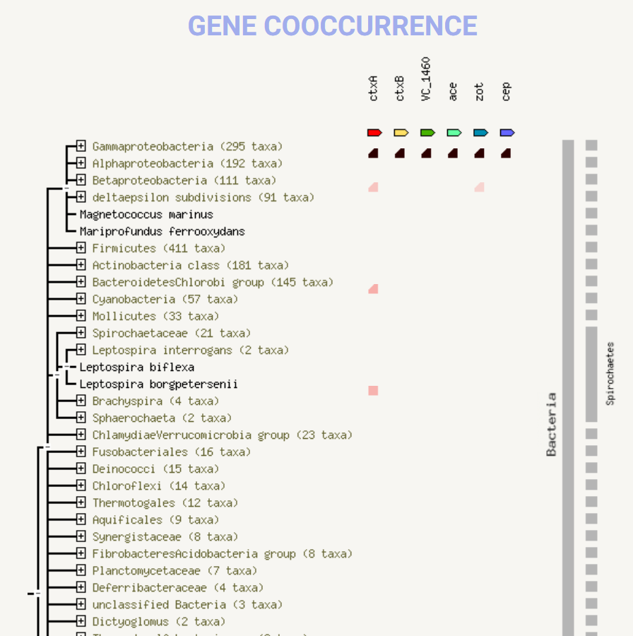
Example 3: Using STRING with a bacterial protein
3. Which proteins tend to co-occur with ctxA?

Slide 19
Exercise 4: Using STRING with a bacterial protein
Search htpX from Brucella abortus.
Show interactions based on experiments and neighborhood. Take a note on which ones have experimental evidence.
Look at the Neighborhood view. Are the genes known to interact with htpX with experimental evidence located around the htpX gene?
Which evolutionary escenarios can you suggest gave rise to the presence of htpX homologs in some but not all bacteria phyla?

Slide 20
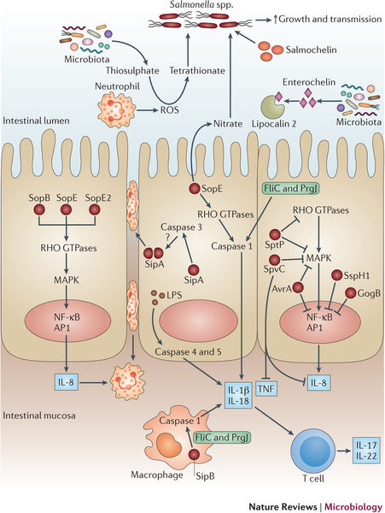
Sip A from Salmonella enterica

Slide 21
Exercise 5: Using STRING with another bacterial protein
Search sipA from Salmonella enterica LT2
Look at the name of the proteins, is there any pattern?
Look at the Neighborhood view. Could you guess what the operon arrangement is in the genomic locus you are observing?

Slide 22
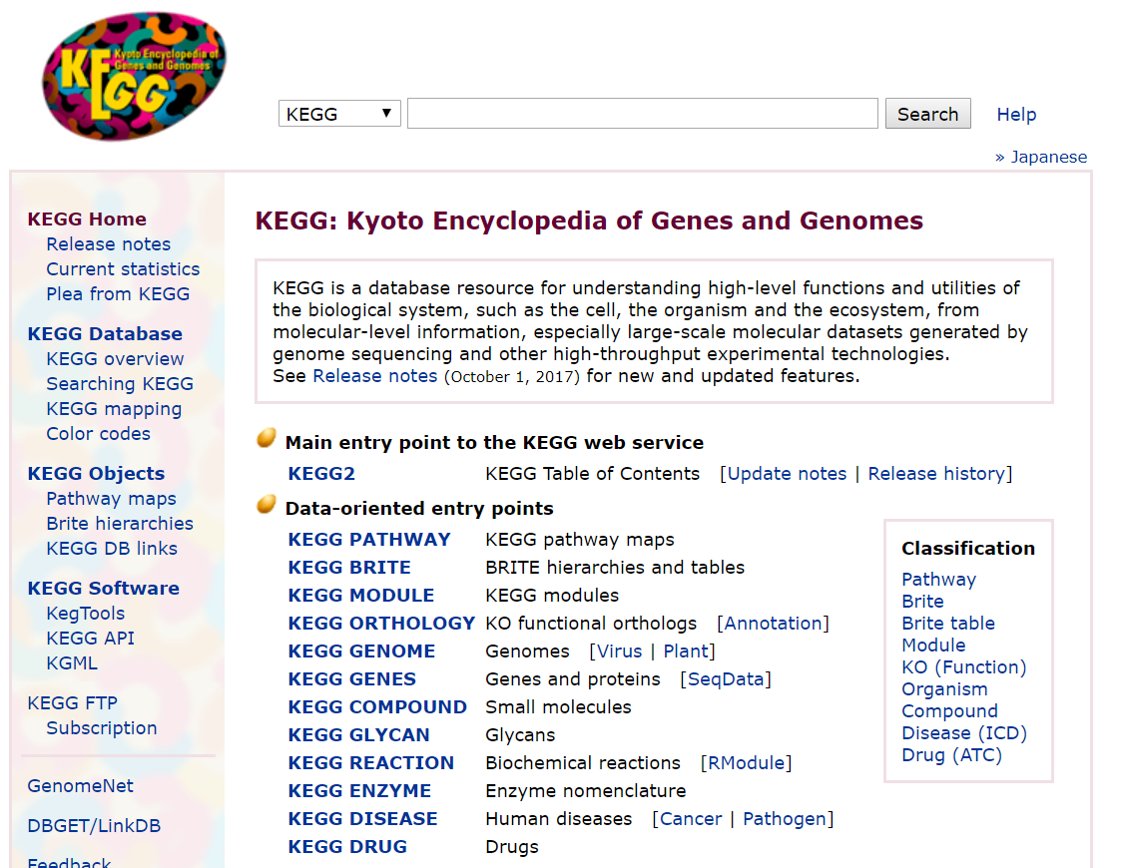
KEGG: http://www.kegg.jp/

Slide 23
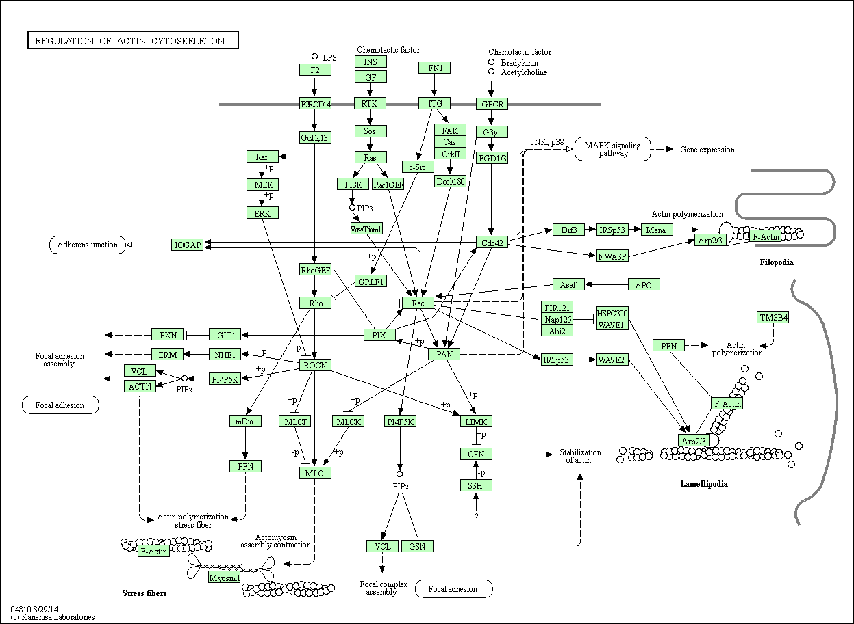
KEGG
- Pathways
- Cellular Processes
- Cell Motility
- Regulation of actin cytoskeleton

Slide 24
Example 6: Exploring members of one Actin pathway
Explore the pathway, click on rectangles, read the descriptions.
Type in the search space “NCK”, what happens?

Slide 25
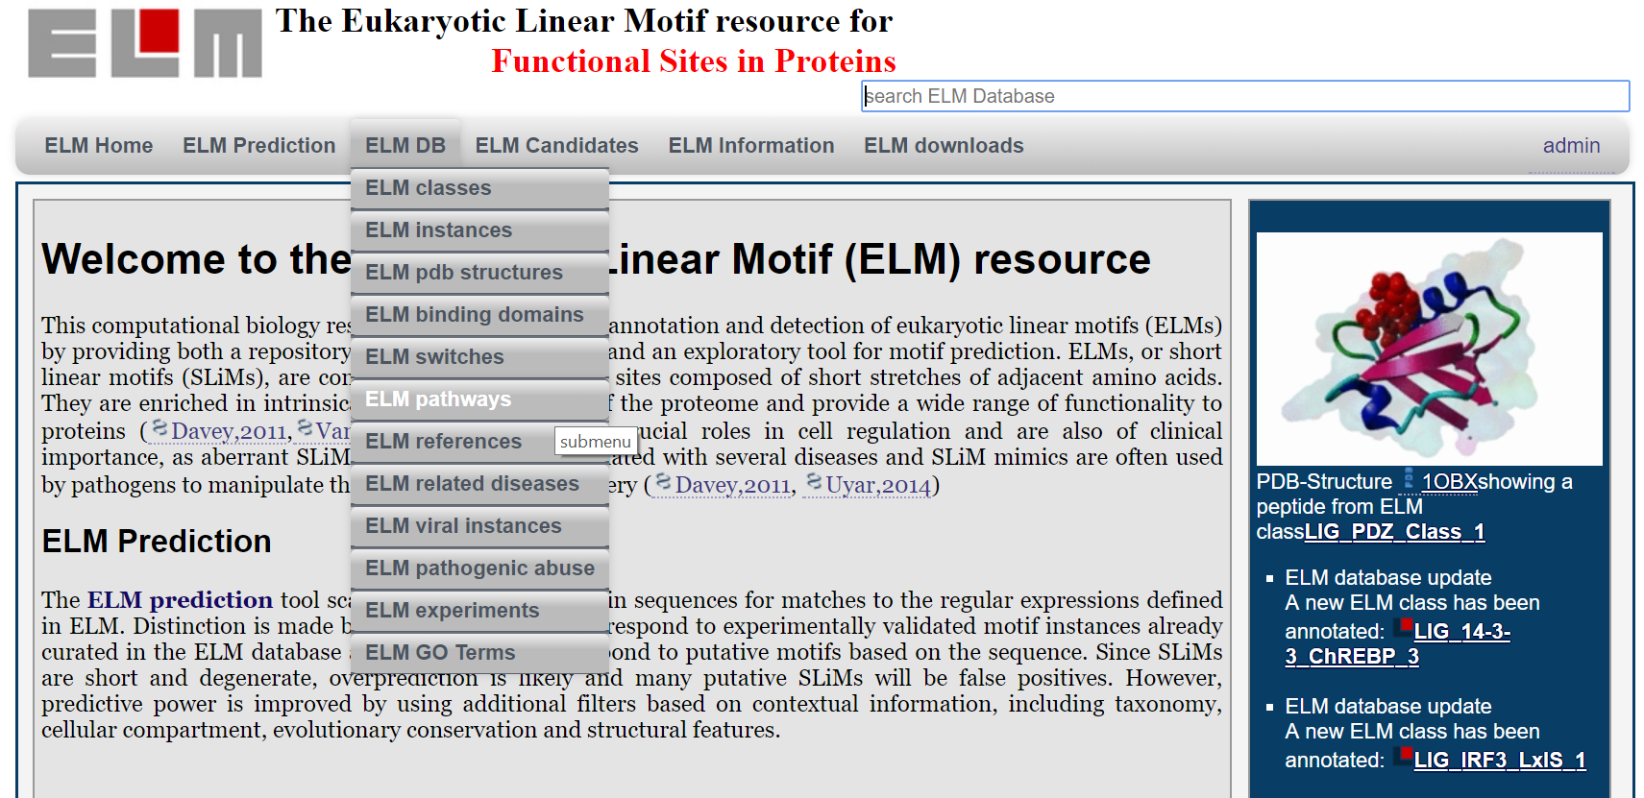
Example 7: Explore ELMs in KEGG
Go to ELM (http://elm.eu.org) -> ELM DB -> ELM Pathways

Slide 26
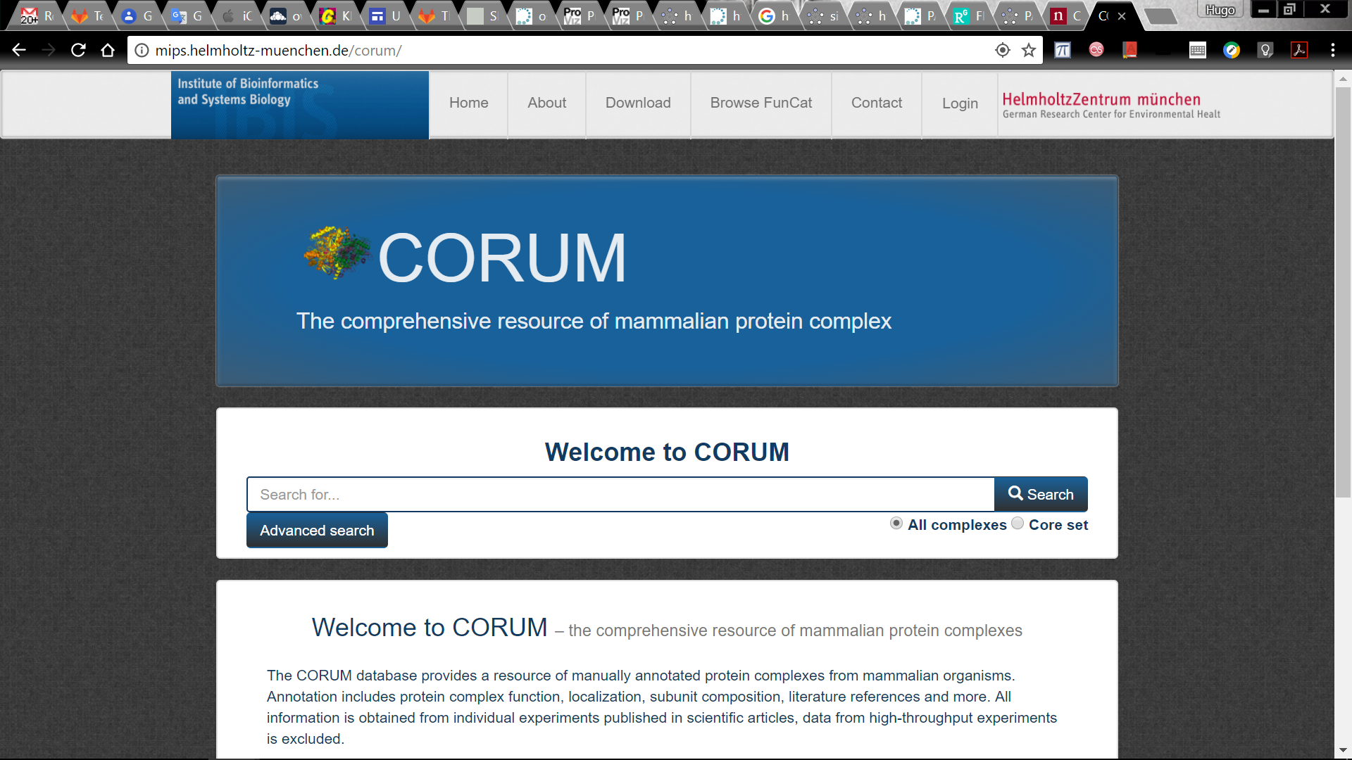
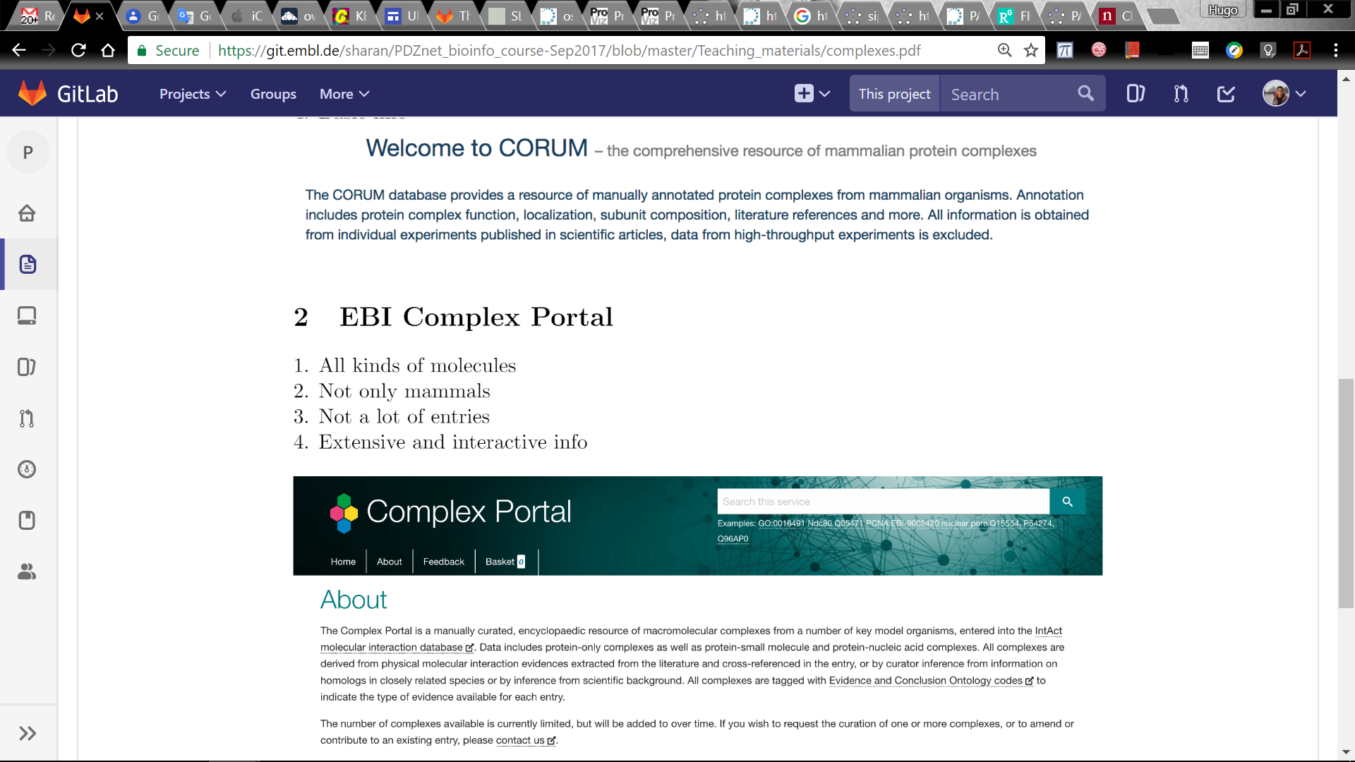
Other databases for protein complexes
http://mips.helmholtz-muenchen.de/corum/
https://www.ebi.ac.uk/complexportal/

Slide 27
Questions?

